Slide 1
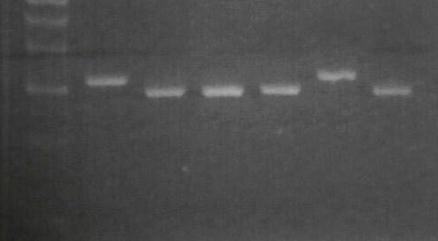
Mol. W. (bp)
cry2 assay
phyB assay
A
B
WT
A
B
WT
400
300
200
100

